Slide 1
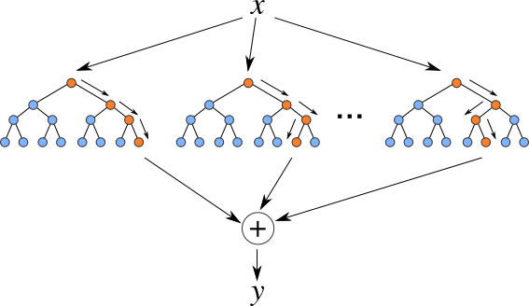
Algorithm : Random Forest(Regression)
Presented by ,
Kavya K C

Slide 2
Contents
Random forest
Ensemble learning & Its Types
Random forest Regression
Components & Hyperparameters
Drawbacks of decision trees
Working
Mathematical understanding with example
Advantages &disadvantages
Applications
References

Slide 3
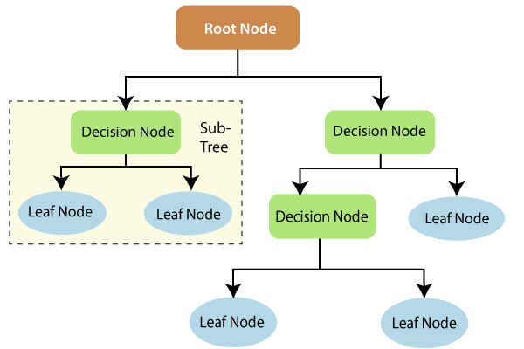
What is random forest?
Random Forest is a powerful and versatile supervised machine learning algorithm that grows and combines multiple decision trees to create a “forest.”
It can be used for both classification and regression problems in R and Python.

Slide 4
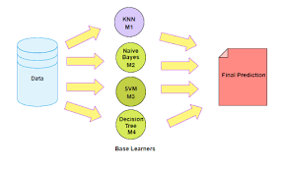
Ensemble learning
Ensemble learning helps improve machine learning results by combining several models.
An ensemble method is a technique that combines the predictions from multiple machine learning algorithms together to make more accurate predictions than any individual model.
A model comprised of many models is called an ensemble model.

Slide 5
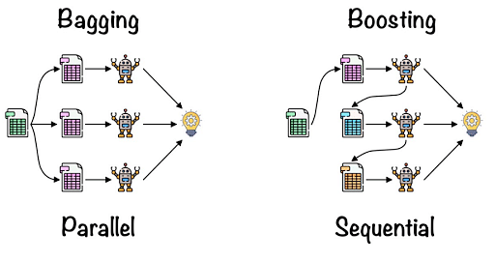
Kinds of Ensemble learning
Boosting
Bootstrap Aggregation (Bagging)
Bagging: Creating a different training subset from sample training data with replacement is called Bagging. The final output is based on majority voting.
Boosting: Combining weak learners into strong learners by creating sequential models such that the final model has the highest accuracy is called Boosting. Example: ADA BOOST, XG BOOST.

Slide 6
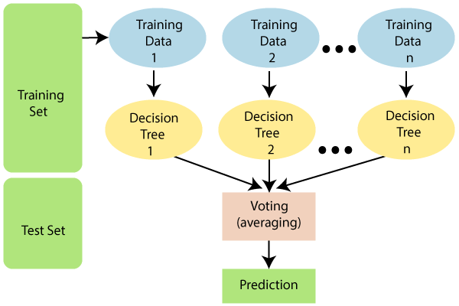
Random forest Regression
Random Forest Regression is a supervised learning algorithm that uses ensemble learning(Bagging) method for regression.
The algorithm operates by constructing a multitude of decision trees at training time and outputting the mean/mode of prediction of the individual trees.
Random forest regression is used to solve a variety of business problems where the company needs to predict a continuous value: Predict future prices/costs.

Slide 7
Components of Random forest Regression
Entropy : It is a measure of randomness or unpredictability in the data set.
Information Gain : A measure of the decrease in the entropy after the data set is split is the information gain.
Leaf Node :A leaf node is a node that carries the decision.
Decision Node : A node that has two or more branches.
Root Node : The root node is the topmost decision node, which is where you have all of your data.

Slide 8
Hyperparameters
n_estimators — the number of decision trees you will be running in the model
criterion — This variable allows you to select the criterion (loss function) used to determine model outcomes. We can select from mean squared error (MSE) and mean absolute error (MAE). The default value is MSE.
max_depth — this sets the maximum possible depth of each tree
max_features — the maximum number of features the model will consider when determining a split
random_state : Controls randomness of the sample. The model will always produce the same results if it has a definite value of random state and if it has been given the same hyperparameters and the same training data.
oob_score : OOB (Out Of the Bag) is a random forest cross-validation method. In this, one-third of the sample is not used to train the data but to evaluate its performance.

Slide 9
Drawbacks of Decision trees
Decision trees are computationally expensive to train, carry a big risk of overfitting.
May get deviations in predictions ,if the data gets changed.
To address these weaknesses, we turn to random forest, which illustrates the power of combining many decision trees into one model.

Slide 10
Working
The following steps explain the working Random Forest Algorithm:
Pick a random K data points from the training set.
Build the decision tree associated to these K data points.
Choose the number N tree of trees you want to build and repeat steps 1 and 2.
For a new data point, make each one of your N-tree trees predict the value of Y for the data point in the question, and assign the new data point the average across all of the predicted Y values.

Slide 11
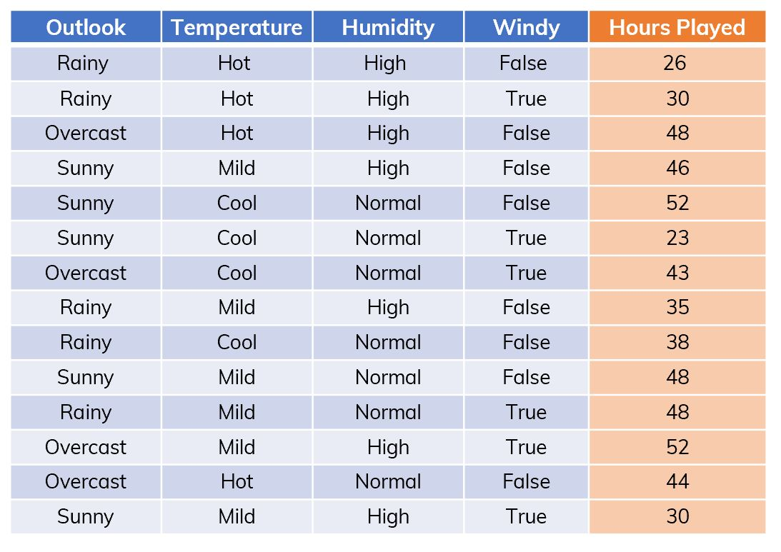
Mathematical understanding of Random forest regression with example

Slide 12
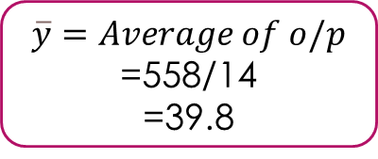
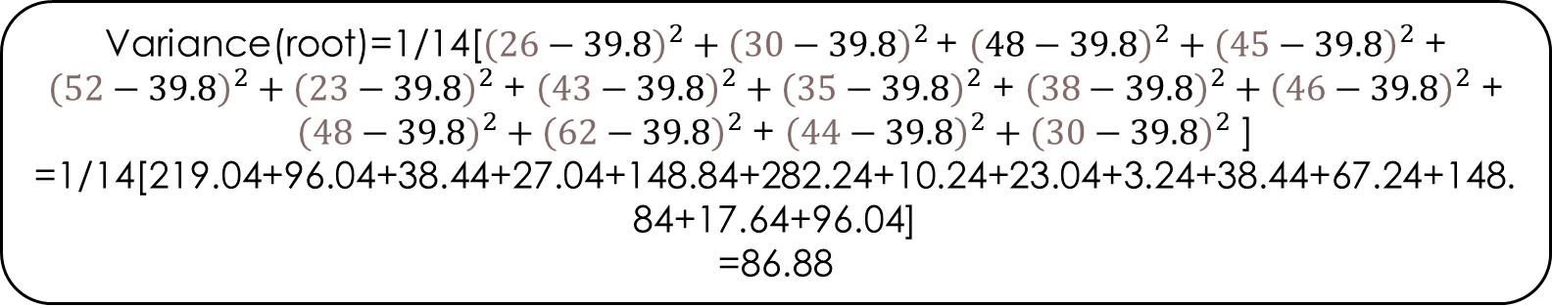
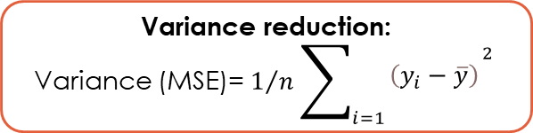
Variance(root)=1/14[${\left(26−39.8\right)}^{2}+{\left(30−39.8\right)}^{2}$ + ${\left(48−39.8\right)}^{2}+{\left(45−39.8\right)}^{2}$ + ${\left(52−39.8\right)}^{2}+{\left(23−39.8\right)}^{2}$ + ${\left(43−39.8\right)}^{2}+{\left(35−39.8\right)}^{2}$ + ${\left(38−39.8\right)}^{2}+{\left(46−39.8\right)}^{2}$ + ${\left(48−39.8\right)}^{2}+{\left(62−39.8\right)}^{2}$ + ${\left(44−39.8\right)}^{2}+{\left(30−39.8\right)}^{2}$ ]
=1/14[219.04+96.04+38.44+27.04+148.84+282.24+10.24+23.04+3.24+38.44+67.24+148.84+17.64+96.04]
=86.88
Humidity
Variance reduction:
Variance (MSE)= $1/n\sum_{i=1}{\begin{aligned}{\left(y_{i}−\overline{y}\right)}^{\begin{aligned}2 \\ \end{aligned}} \\ \end{aligned}}$
outlook
overcast
Rainy
Sunny
High
Normal
$$\overline{y}=Average of o/p$$
=558/14
=39.8
48,43,62,44
26,30,36,38,48
46,62,23,48,30
26,30,48,45,36,62,30
62,23,43,38,48,48,44

Slide 13
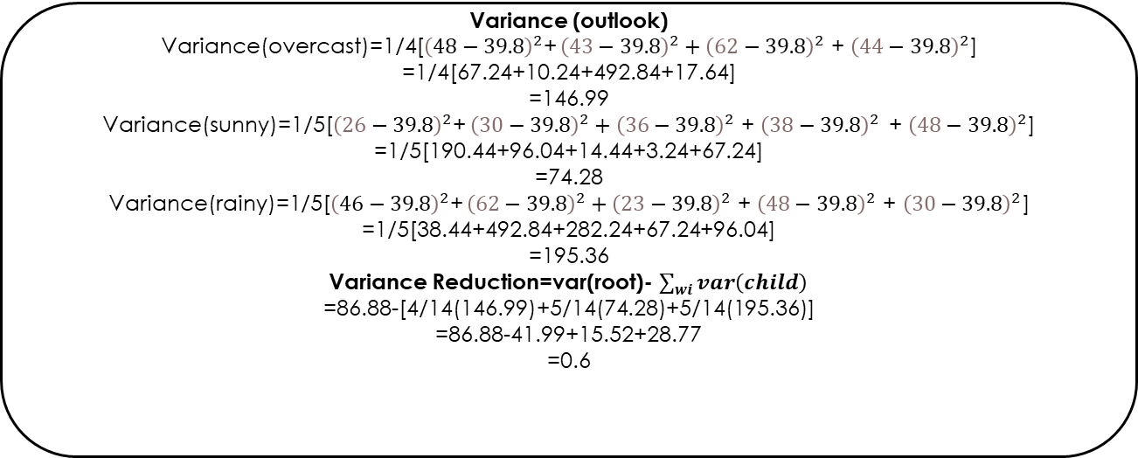
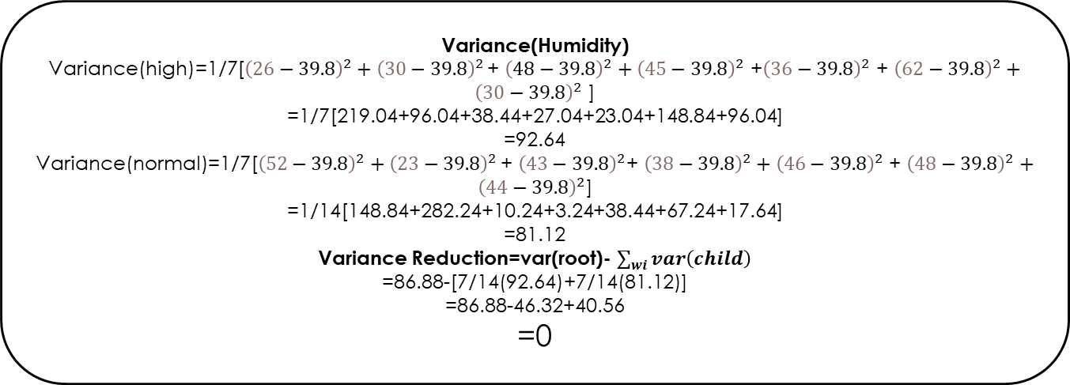
Variance (outlook)
Variance(overcast)=1/4[${\left(48−39.8\right)}^{2}$+ ${\left(43−39.8\right)}^{2}+{\left(62−39.8\right)}^{2}$ + ${\left(44−39.8\right)}^{2}$]
=1/4[67.24+10.24+492.84+17.64]
=146.99
Variance(sunny)=1/5[${\left(26−39.8\right)}^{2}$+ ${\left(30−39.8\right)}^{2}+{\left(36−39.8\right)}^{2}$ + ${\left(38−39.8\right)}^{2 }$ + ${\left(48−39.8\right)}^{2}$]
=1/5[190.44+96.04+14.44+3.24+67.24]
=74.28
Variance(rainy)=1/5[${\left(46−39.8\right)}^{2}$+ ${\left(62−39.8\right)}^{2}+{\left(23−39.8\right)}^{2}$ + ${\left(48−39.8\right)}^{2}$ + ${\left(30−39.8\right)}^{2}$]
=1/5[38.44+492.84+282.24+67.24+96.04]
=195.36
Variance Reduction=var(root)- $\sum_{wi}{var\left(child\right)}$
=86.88-[4/14(146.99)+5/14(74.28)+5/14(195.36)]
=86.88-41.99+15.52+28.77
=0.6
Variance(Humidity)
Variance(high)=1/7[${\left(26−39.8\right)}^{2}+{\left(30−39.8\right)}^{2}$ + ${\left(48−39.8\right)}^{2}+{\left(45−39.8\right)}^{2}$ +${\left(36−39.8\right)}^{2}$ + ${\left(62−39.8\right)}^{2}+{\left(30−39.8\right)}^{2}$ ]
=1/7[219.04+96.04+38.44+27.04+23.04+148.84+96.04]
=92.64
Variance(normal)=1/7[${\left(52−39.8\right)}^{2}+{\left(23−39.8\right)}^{2}$ + ${\left(43−39.8\right)}^{2}$+ ${\left(38−39.8\right)}^{2}+{\left(46−39.8\right)}^{2}$ + ${\left(48−39.8\right)}^{2}+{\left(44−39.8\right)}^{2}$]
=1/14[148.84+282.24+10.24+3.24+38.44+67.24+17.64]
=81.12
Variance Reduction=var(root)- $\sum_{wi}{var\left(child\right)}$
=86.88-[7/14(92.64)+7/14(81.12)]
=86.88-46.32+40.56
=0
VR(outlook)>VR(Humidity)

Slide 14
Advantages & Disadvantages
Advantages:
Can perform both Regression and classification tasks.
Produces good predictions that can be understood easily.
Can handle large data sets efficiently.
Provides a higher level of accuracy in predicting outcomes over the decision algorithm.
Disadvantages:
Extremely complex and More resources are required for computation.
Consumes more time compared to the decision tree algorithm.
Less intuitive when we have an extensive collection of decision trees.

Slide 15
Applications
Banking: It predicts a loan applicant’s solvency. This helps lending institutions make a good decision on whether to give the customer loan or not. They are also being used to detect fraudsters.
Health Care: Health professionals use random forest systems to diagnose patients. Patients are diagnosed by assessing their previous medical history. Past medical records are reviewed to establish the proper dosage for the patients.
Stock Market: Financial analysts use it to identify potential markets for stocks. It also enables them to remember the behaviour of stocks.
E-Commerce: Through this system, e-commerce vendors can predict the preference of customers based on past consumption behaviour.

Slide 16
References
https://www.javatpoint.com/machine-learning-random-forest-algorithm
https://en.wikipedia.org/wiki/Ensemble_learning
https://towardsdatascience.com/random-forest-regression-5f605132d19d
https://www.youtube.com/watch?v=RUEFSwN-orQ
https://www.analyticsvidhya.com/blog/2021/03/introduction-to-random-forest-and-its-hyper-parameters/
https://www.educba.com/decision-tree-limitations/

